Slide 1
Lecture 4-6
Data Structures
Presented By:
Marina Gul

Slide 2
Topics to be covered
Recap of the previous lecture
Linked List
Doubly-Linked List

Slide 3
Suppose you want to arrange the following marks(data) in ascending order
23
70
3
100
54
12
5
3 | 5 | 12 | 23 | 54 | 70 | 100

Slide 4
There are two ways to store the list in memory
Arrays
Linked List

Slide 5
Limitation of arrays
Fixed Size: When you create an array, you have to decide the size in advance. If you need more space later, you can't just add more. You would need to get a new array and move everything over, which is time-consuming.
Inefficient Insertion and Deletion: Adding or removing items in the middle of the array requires shifting the other items. If you want to insert a new item at position 3, you need to move everything from position 3 onward to the next position.
Efficient Memory Utilization: Arrays, when declared, take up a block of memory that is equal to the maximum size irrespective of the usage.

Slide 6
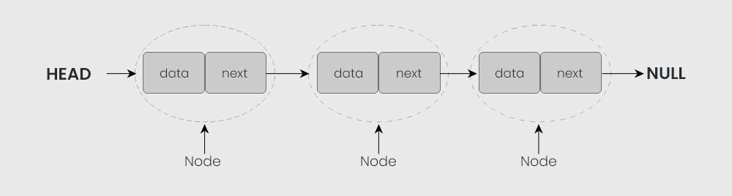
Linked List
A linked list is a linear data structure, in which the elements are not stored at contiguous memory locations. The elements in a linked list are linked using pointers as shown in the below image:

Slide 7
A linked list uses extra memory to store links.
During the initialization of the linked list, there is no need to know the size of the elements.
Linked lists are used to implement stacks, queues, graphs, etc.
The first node of the linked list is called the Head.
The next pointer of the last node always points to NULL.
In a linked list, insertion and deletion are possible easily.
Each node of the linked list consists of a pointer/link which is the address of the next node.
Linked lists can shrink or grow at any point in time easily.

Slide 8
Times for Common operation
 | Add | Remove
Beginning
End
2
10
14
5
head

Slide 9
Times for Common operation
 | Add | Remove
Beginning
End
50
2
10
14
5
head

Slide 10
Times for Common operation
 | Add | Remove
Beginning | O(1)
End
50
2
10
14
5
head

Slide 11
Times for Common operation
 | Add | Remove
Beginning | O(1)
End
50
2
10
14
5
head

Slide 12
Times for Common operation
 | Add | Remove
Beginning | O(1) | O(1)
End
2
10
14
5
head

Slide 13
Times for Common operation
 | Add | Remove
Beginning | O(1) | O(1)
End | O(n) | O(n)
2
10
14
5
head

Slide 14
Times for Common operation
 | Add | Remove
Beginning | O(1) | O(1)
End
2
10
14
5
head
Suppose we have tail for storing the address last node
tail

Slide 15
Times for Common operation
 | Add | Remove
Beginning | O(1) | O(1)
End
2
10
14
5
head
8
tail

Slide 16
Times for Common operation
 | Add | Remove
Beginning | O(1) | O(1)
End
2
10
14
5
head
8
tail

Slide 17
Times for Common operation
 | Add | Remove
Beginning | O(1) | O(1)
End | O(1)
2
10
14
5
head
8
tail

Slide 18
Times for Common operation
 | Add | Remove
Beginning | O(1) | O(1)
End | O(1)
2
10
14
5
head
8
tail

Slide 19
Times for Common operation
 | Add | Remove
Beginning | O(1) | O(1)
End | O(1) | O(n)
2
10
14
5
head
tail

Slide 20
Single-Linked List
Single Linked List | No tail | With tail
addToFront(data) | O(1)
removeFromFront() | O(1)
returnFront() | O(1)
addToBack(data) | O(n) | O(1)
removeFromBack() | O(n)
returnBack() | O(n) | O(1)
find(data) | O(n)
isListEmpty() | O(1)
addNodeAfter(Node,data) | O(1)
addNodeBefore(Node,data) | O(n)

Slide 21
When to use Linked List
Dynamic Data Structures: When you don't know in advance how many elements you'll need, linked lists are useful because they can grow and shrink as necessary.
Frequent Insertions/Deletions: If your application frequently adds or removes items in the middle (or start) of the list, a linked list is more efficient than an array because you avoid the need to shift elements

Slide 22
class Node{ int data; Node next; //Constructor Node(int data) { this.data=data; this.next=null; } }
void printList() { Node node = head; while (node.next != null){ System.out.print(node.data + " "); node = node.next; } System.out.print(node.data + " "); }
class LinkedList{ Node head; void addToBack(int data) { Node newNode=new Node(data); if(head==null) head=newNode; else{ Node temp=head; while(temp.next!=null) temp=temp.next; temp.next=newNode; } }
void addToFront(int data) { Node newNode =new Node(data); Node temp=head; head=newNode; node.next=temp; }

Slide 23
void removeFromBack() { Node n=head; while(n.next.next!=null) n=n.next; n.next=null; }
void addToMiddle(int index,int data) { Node node =new Node(data); Node n=head; for(int i=1;i<index-1;i++) { n=n.next; } node.next=n.next; n.next=node; }
void deleteAt(int index) { if (index==1) deleteStart(); } else{ Node n=head; Node temp=null; for(int i=1;i<index-1;i++) { n=n.next; } temp=n.next; n.next=temp.next; }
boolean isListEmpty() { return head == null; }
void deleteStart() { head=head.next; }

Slide 24
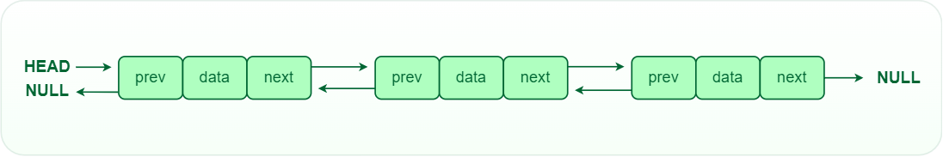
Doubly-Linked List
Traversal of items can be done in both forward and backward directions as every node contains an additional prev pointer that points to the previous node.

Slide 25
Doubly-Linked List
2
10
14
5
head
tail

Slide 26
Doubly-Linked List
2
10
14
5
tail
head

Slide 27
Doubly-Linked List
2
10
14
tail
head
Remove at End: O(1)

Slide 28
Doubly-Linked List
Doubly Linked List | No tail | With tail
addToFront(data) | O(1)
removeFromFront() | O(1)
returnFront() | O(1)
addToBack(data) | O(n) | O(1)
removeFromBack() | O(n) | O(1)
returnBack() | O(n) | O(1)
find(data) | O(n)
isListEmpty() | O(1)
addNodeAfter(Node,data) | O(1)
addNodeBefore(Node,data) | O(n)

Slide 29
Recap of the Lecture
Constant time to insert at or remove from the front.
With tail and doubly-linked, constant time to insert at or remove from the back.
O(n) time to find arbitrary element.
List elements need not be contiguous.
With doubly-linked list, constant time to insert between nodes or remove a node

